Slide 1
Innovation and educational interventions at school
KA101 – School education staff mobility
2019-1-EL01-KA101-061844
2019-2020 Second Lyceum of Kalamaria

Slide 2
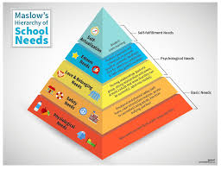
Basic needs of School Unit
The basic needs of our school unit resulting after research and analysis are identified in 4 key areas.
1. Effective operation of the unit and encouragement of participation and cooperation of teachers and students.
2. Prevention and management of crises and conflicts inside school.
3. Integration of foreign students into the school community and the avoidance of student leakage
4. Adoption of innovative STEM teaching methods.

Slide 3
Key Action 1. School Leadership and Educational Innovation
The effective functioning of school unit is based on strategic planning and effective management of human resources. It is therefore necessary the Head of the School Unit to participate in a course
aimed at inspirational leadership
planning and implementation programs and actions that strengthen teacher-student relationships
and enhance participation, collaboration and exchange of experiences and ideas between European schools.

Slide 4
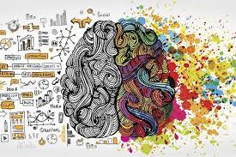
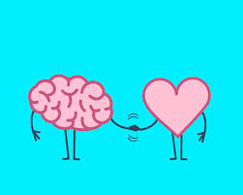
Key Action 2. Conflict Management,
Emotional Intelligence and Bullying Prevention
Crisis prevention and management is a fairly common phenomenon in modern schools. In particular, our school has previously been called upon to deal with incidents of conflict, harassment and bullying, without teachers being able to recognize or deal with such incidents.
Recognizing, differentiating and responding to the ever-present crises and to aggressive behaviors among students and teachers, can often used as a tool and an incentive to build a resilient school community. So, it was considered necessary for a teacher to be involved in a course aimed at dealing with problematic situations and aggressive behaviors that create an unfavorable classroom environment and inhibit the learning process.

Slide 5
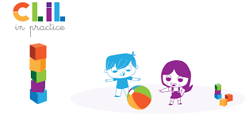
Key Action 3. CLIL in Practice
In Greece nowadays there are many students who do not have Greek as their mother language and the leakage of these students is quite intense.
Learning Greek language on issues of students’ interest, enhances their normal integration into the school community and develops communication skills and cooperation. In addition, all students broaden their knowledge of languages ​​and cultures in a natural, exploratory and discoverable way.
So, it was considered necessary for a teacher to participate in a course about languages such as CLIL.

Slide 6
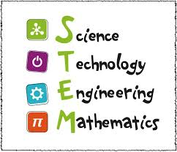
Key Action 4. STEM Education: Concepts, Methodologies, Tools and Applications
One of the basic needs of the school unit is the adoption of innovative methods of teaching that incorporate scientific concepts into the educational process in such ways that motivate students' interest.
So, it was considered necessary for one of our teachers to attend a course that focus on
integrating and utilizing educational applications in educational practice
enhancing teaching and learning with additional supporting material.
Through this course our teacher will enhance the confidence to integrate to his/her lesson plans new objects and upgrade its quality educational project.
In addition, STEM technology will provide additional incentives for students and will enhance exploratory and discovery learning.

Slide 7
Questions ?

